Slide 1
CSS Multiple Backgrounds
BY: Amy Storrs

Slide 2
Multiple Backgrounds
Multiple backgrounds can be applied to elements
Backgrounds will be layered on top of each other with the first background you provide on top and the last background listed in the back.
NOTE: ONLY the LAST background can include a background color
NOTE: Either a local file location or a web location can be used for image location
There are two ways to do the multiple backgrounds
The long way
The shorthand way

Slide 3
The Long Way
In using the Longhand way the following properties can be specified:
Background
Background-attachment
Background-clip
Background-image
Background-origin
Background-position
Background-repeat
Background-size

Slide 4
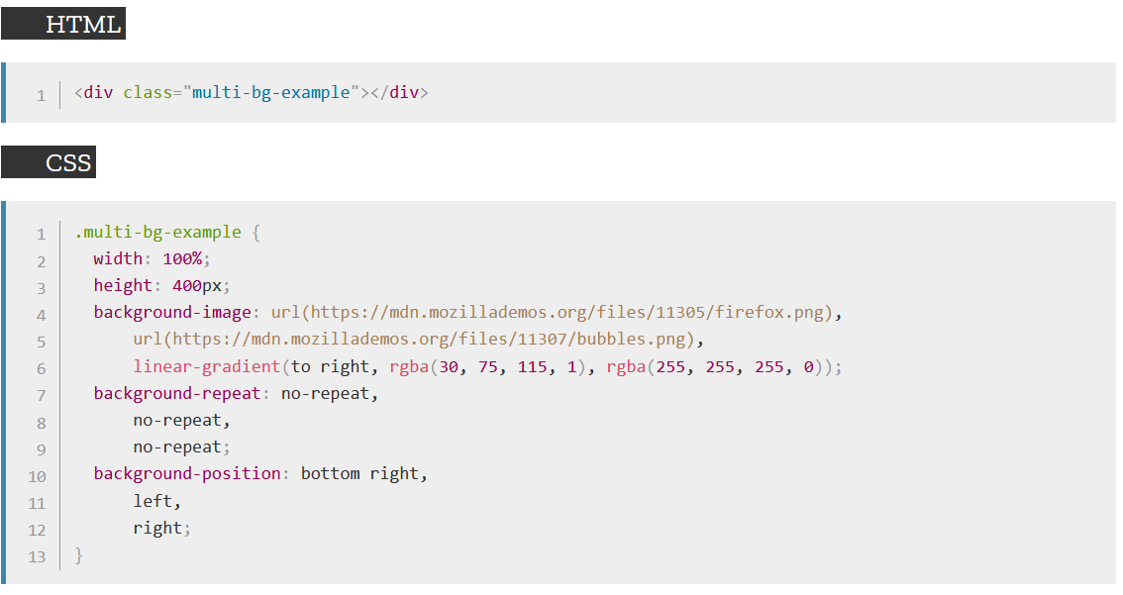
The Long Way - Example

Slide 5
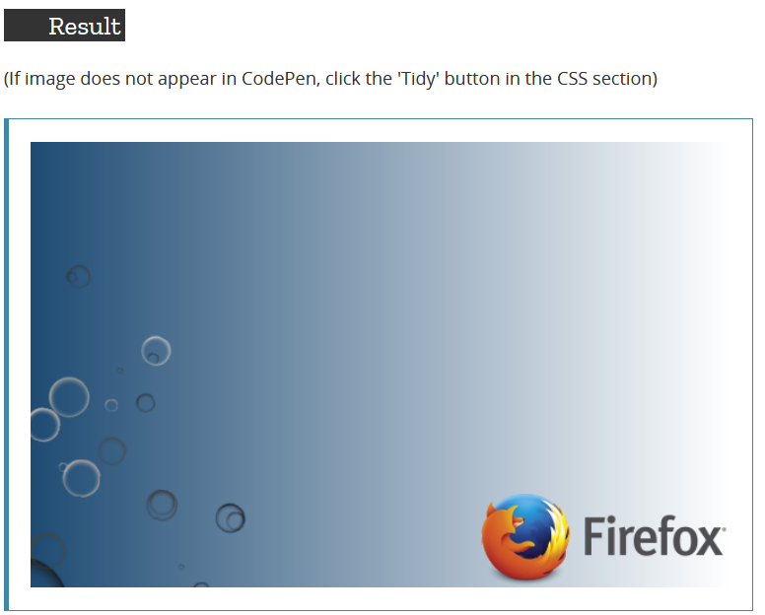
The Long Way – Example Result

Slide 6
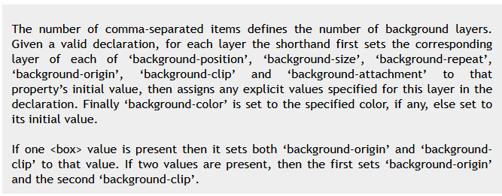
The Shorthand Way
In using the Shorthand way please NOTE the following:

Slide 7
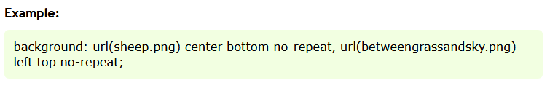
The Shorthand Way - Example

Slide 8
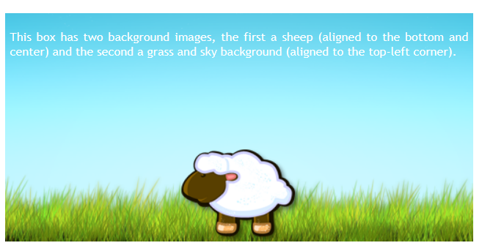
The Shorthand Way – Example Result

Slide 9
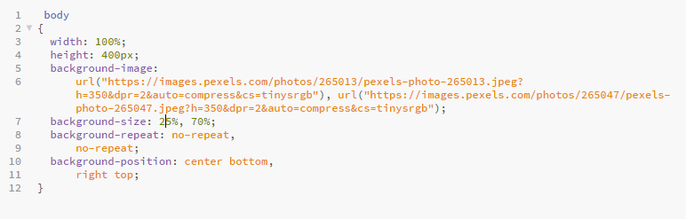
Example – The Long Way

Slide 10
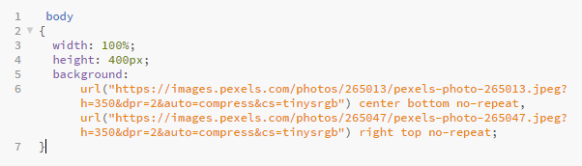
Example – The Shorthand Way

Slide 11
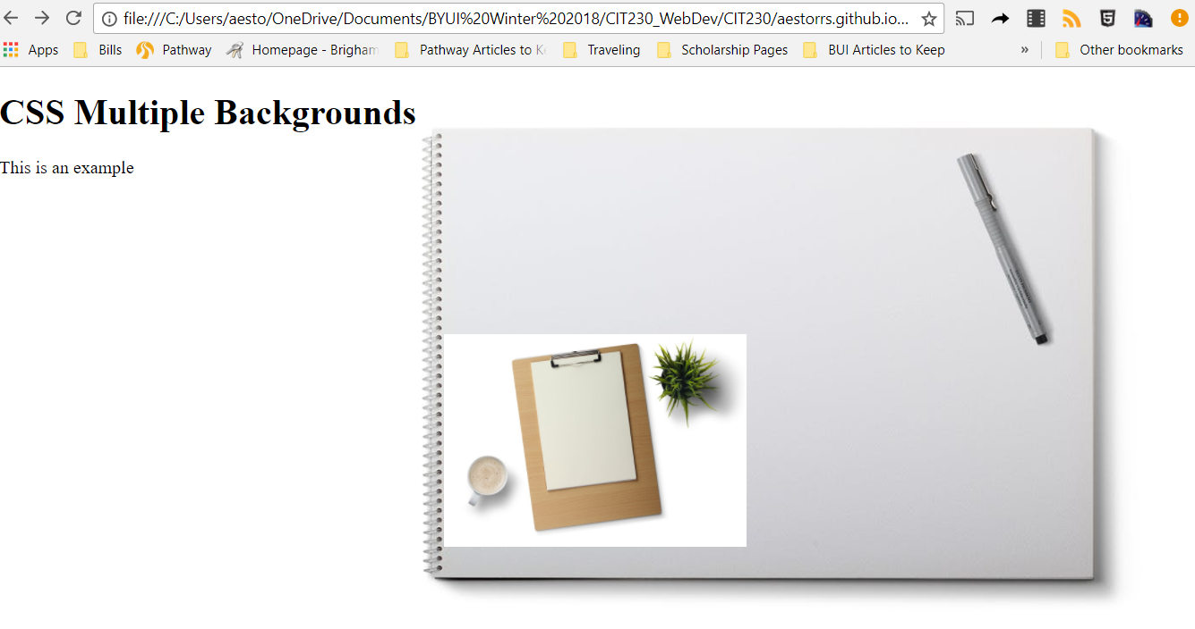
Example – Result

Slide 12
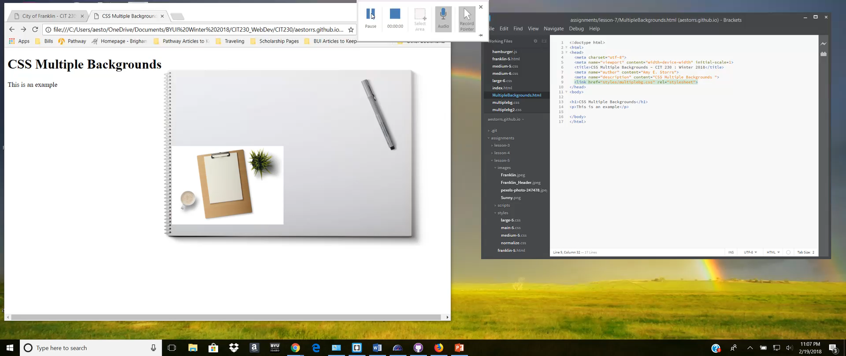
Demo – The Long Way

Slide 13
References
Css3.info. (2018). Multiple Backgrounds with CSS3 - CSS3 . Info. [online] Available at: http://www.css3.info/preview/multiple-backgrounds/ [Accessed 18 Feb. 2018].
MDN Web Docs. (2018). Using multiple backgrounds. [online] Available at: https://developer.mozilla.org/en-US/docs/Web/CSS/CSS_Backgrounds_and_Borders/Using_multiple_backgrounds [Accessed 18 Feb. 2018].
W3schools.com. (2018). CSS Multiple Backgrounds. [online] Available at: https://www.w3schools.com/css/css3_backgrounds.asp [Accessed 18 Feb. 2018].

